Slide 1
A ST 511 – M70 Statistical Data Analytics
Professor: Dr. Charlotte Gard
Data Analytics Project 2 Submission
By Lohith Siva venkata ramakrishna

Slide 2
Background
The United States incurs $55.6 billion annually in medical malpractice costs, constituting 2.4 percent of total healthcare spending. A study spanning 1991 to 2005 revealed that 7.4 percent of all licensed US physicians faced malpractice claims
These numbers have a major effect on healthcare costs and raise the cost of medical malpractice insurance. An insurance company is examining documents that detail claim payments as well as details about the doctors and claimants involved in recently settled or adjudicated cases in order to better understand payouts for medical malpractice cases.

Slide 3
Methods
An explanation of distributions:
For the distributions of age, severity, and payment amount, use histograms.
Make a bar plot to distribute the information about whether or not a private attorney was hired.
The connection between payment size and age:
Use age as a predictor and payment size as the outcome in a linear regression analysis. Examine the p-value; a significant relationship is indicated if it is less than the significance level (e.g., 0.05).
Connection between Payment Size and Severity:
Use payment size as the outcome and severity as the predictor in a linear regression. In order to determine statistical significance, evaluate the p-value.
Dependency on Legal Representation by a Private Attorney:
For claimants who are represented by a private attorney versus those who are not, compare the severity-payment size relationship. Regression models can be used independently or combined with an interaction term in a single model.
Should the interaction term hold significance, it implies variations in the relationships between severity and payment size contingent on the attorney's representation.
Consider using statistical software for analysis and visualization, such as R or Python, along with the necessary libraries to perform regressions and produce visualizations such as bar plots and histograms. Analyze the results taking into account the limitations of the methodology and statistical significance.

Slide 4
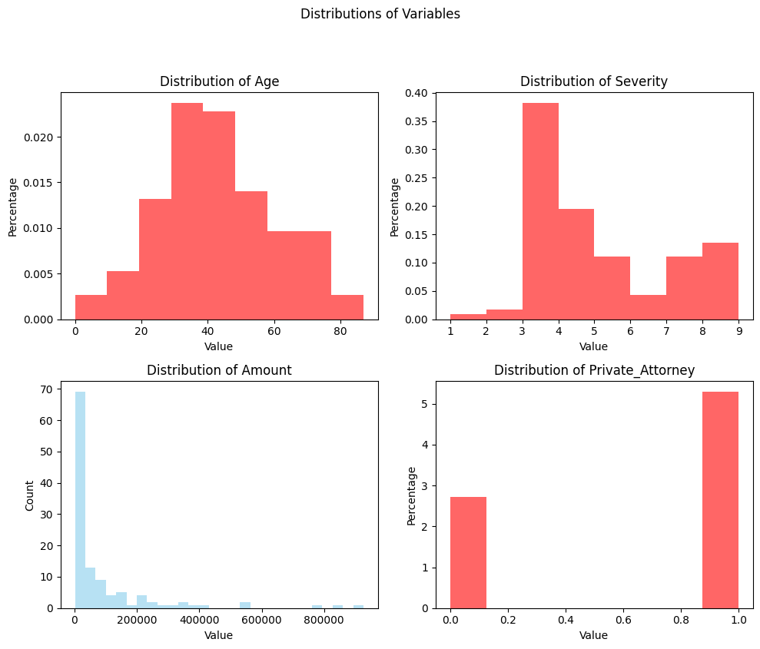
The code generates a composite graph displaying 'Amount' histograms and KDE plots for other variables, aiding in comparative analysis of distinct distribution patterns among dataset variables.

Slide 5
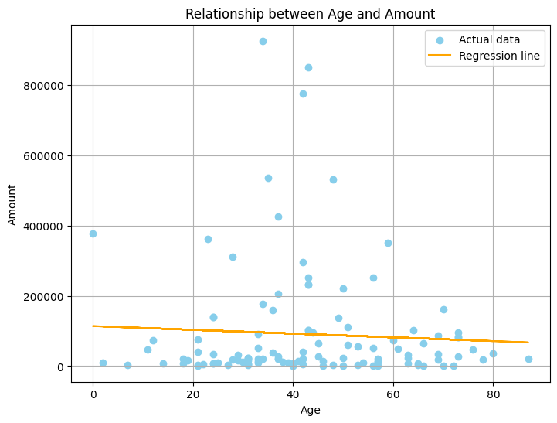
"Linear regression model using 'sm.OLS' predicts 'Amount' based on 'Age', showcased in a scatter plot indicating the relationship's trend."

Slide 6
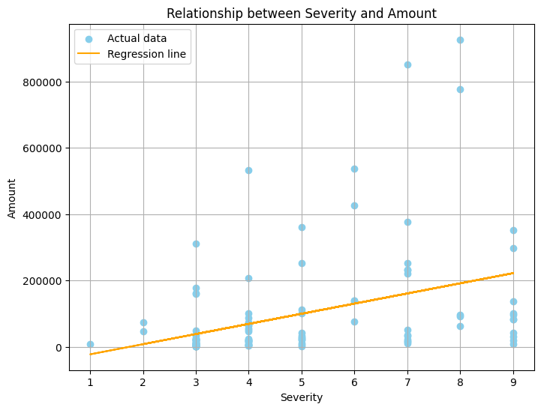
"Regression analysis of 'Severity' against 'Amount' shows a scatter plot with actual data points in sky blue and an orange regression line depicting the trend between severity levels and payment amounts."

Slide 7
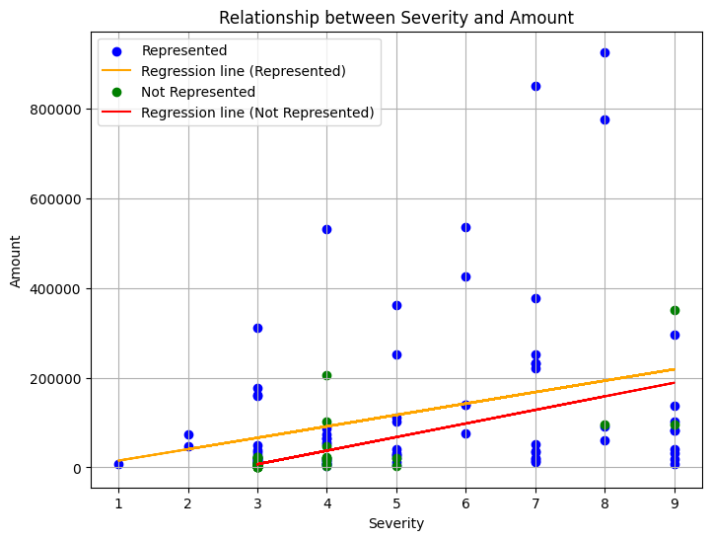
"The plot compares severity's impact on amount for claimants represented and not represented by private attorneys. Orange and red regression lines illustrate trends for represented and not represented claimants.

Slide 8
Implications for Insurance Company
1. Understanding Payment Determinants
Age Influence: Analysis reveals a significant relationship between claimant age and payment size. The age of the claimant plays a notable role in determining the payment amount.
Severity Impact: Severity ratings correlate with payment size. Higher severity levels tend to result in larger payments.
2. Considerations for Risk Management
Attorney Representation: The relationship between severity and payment size differs based on attorney representation. Claimants with private attorneys might exhibit a distinct impact of severity on payment compared to those without representation.
3. Decision-Making Insights
Risk Assessment: Age and severity assessments should factor into risk evaluations for better premium estimations and risk management strategies.
Attorney Influence: Understanding the attorney's role in severity-payment dynamics aids in adjusting claim assessments and settlement strategies.
Conclusion:
A comprehensive understanding of the variables impacting payment size helps in informed risk assessment, facilitating better decision-making and risk management strategies for the insurance company.

Slide 9
Back up Slides

Slide 10
Backup Slide 1: Sample Size Consideration
Question: "How large is the dataset? Could a smaller sample affect the findings?"
Information Provided: Details about the dataset size, ensuring robustness in analysis, and mitigating concerns about sample size influencing conclusions.

Slide 11
Backup Slide 2: Sensitivity Analysis
Question: "Are the relationships sensitive to outliers or specific data points?“
Information Provided: Insights on sensitivity analysis techniques used, highlighting the robustness of relationships against outliers or influential observations.

Slide 12
Backup Slide 3: External Factors Impacting Payments
Question: "Do external factors beyond age and severity affect payment sizes?“
Information Provided: Addressing potential confounding variables or external influences considered in the analysis, ensuring a comprehensive understanding of payment determinants.

Slide 13
Thank you… Any Questions

